Slide 1
Data Science Workshop with IBM SPSS Modeler
Add Date and Location and Presenter Name
Notes:
Welcome to the IBM SPSS Predictive Analytics Workshop.
My name is <insert your name, title and brief description of your role or have your local sales rep provide the welcome and introductions>.
<If it is a small group (20 attendees), ask attendees for their names, title, company, role and learning objectives for the workshop. >

Slide 2

Agenda
Welcome and Introductions
Overview of SPSS Data Science
IBM SPSS Modeler Overview
Exercise 1: Predictive in 20 Minutes
IBM SPSS Modeler Basics
Methodology and Applications
Break
Exercise 2: Find Patterns and Groups
Exercise 3: Understand the Past, Predict the Future
Exercise 4: Deploy Insights
SPSS Data Science Platform Integrations
Wrap up and Next Steps
Resources

Slide 3

Introductions
Name and Organization you represent
Does your Organization have any data science initiatives?
Do you have any experience with any IBM SPSS solutions?
SPSS Statistics
SPSS Modeler (formerly Clementine)
SPSS Text Analytics for Surveys (TAfS)
Do you use Open Source?
How did you hear about this workshop?
What are your objectives for today?

Slide 4




Today’s Presenter: Lorem Ipsem
XXXX@us.ibm.com
XXX-XXX-XXX
linkedin.com/in/xxxxxx
Project Experience
XXX
YYY
ZZZ

Slide 5

Purpose Of The Workshop
Introduction to Data Science
Stimulate thinking about how SPSS Data Science would benefit your organization
Demonstrate ease of use of powerful technology
Get hands on experience with SPSS’ Data Science platform
Explore multiple Data Science techniques
Understand the SPSS Data Science portfolio and its integrations across IBM
Notes:
The purpose of this workshop is to deepen your understanding of predictive analytics.
I want you to think about a few challenges and opportunities facing your organization. <Pause briefly.>
By the end of the workshop, my goals are for you to walk away with a better understanding of how you can use predictive analytics to address those opportunities and to have confidence in your ability to use IBM SPSS Modeler to help take your organization to the next level.
Since this is a hands-on workshop, you will be at the controls during the exercises so you can experience how IBM SPSS Modeler works and how easy it can be to get started with predictive analytics within your organization.

Slide 6

Data Science Is For Everyone
Data Science is the analysis of all kinds of data using sophisticated quantitative methods (i.e., statistics, descriptive and predictive data mining, simulation and optimization) to produce insights that traditional approaches to business intelligence (BI) — such as query and reporting — are unlikely to discover.
Notes:
So we had introduced predictive analytics earlier – but let’s use the Gartner definition here. Gareth has been a thought leader within this space for decades. And his definition is very simple.
Note that it does not talk about math, correlations, or the many techniques that are employed in the name of predictive analytics. Predictive analytics is about making better decisions using data. As data around us grows exponentially, the ability to turn it into effective action makes that data a competitive advantage for organizations.
IBM sees data as a new natural resource – and much of the data is organic in nature. It is data that is generated every day, every minute, even every second by people and systems interacting with each other during normal day to day business operations.
Predictive analytics can help you draw reliable conclusions about today and tomorrow.
This notion of reliability is important. Reliability means that you have a measure of confidence in what you are seeing – and you can use that measure of confidence to fine tune the direction of a decision.
Often, that confidence is the nuance that is missing but a nuance that is important – which we’ll demonstrate later in the session.

Slide 7


Why Is Data Science Essential?
Complexity
A single truck visiting 5 different locations
120 different routes
A single truck visiting 10 different locations
Over 3 million routes
Real world problems contain
100s of trucks, 1000s of locations
There are more possibilities that the grains of sands in the world
Notes:
Let’s say you have a single truck that needs to visit 5 different locations and we are trying to determine in what order to visit these locations in order to minimize the distance traveled. The number of different ways in which we can visit these 5 locations is 120. So we can easily enumerate them, sort them and pick the best. If we double the number of locations that we need to visit to 10 then the number of possibilities goes from 120 to over 3 million. So by increasing the inputs by a factor of 2 we increase the possibilities that we need to consider by a factor of 20,000!
Consider now that real world problems contain 100s of trucks and 1000s of locations, the number of possibilities that we have to consider is literally larger than the number of grains of sand in the entire world. It is impossible to look for this proverbial needle or grain in a hay stack even if we had a lifetime to do it. Yet companies like UPS and FedEx solve this problem repeatedly on a daily basis.
This problem is known as the combinatorial explosion, in which the number of combinations that we need to consider grows much faster than what we can keep up with.

Slide 8
A Data Science Application
User interface front end for business-user and end-user interaction
Deployed Data Science models run here
Ingest
Persist
Analyze
Deploy
Collect and save data from internal and external sources
Manipulate, govern and expose data sets
Data Scientists collaborate, explore data sets, create models and use algorithms to produce results
Notes:
A Data Science application follows a simple process flow (i.e., pattern) that can be seen on this slide.
Information is typically collected from a number of diverse sources that can be external like Internet-of-Things sensors, on-line services like the weather as well as internal sources like historical transactional systems that provide a rich history of past consumer behavior. This information is *ingested* by various services and *persisted* in data bases that govern and manipulate the data so that it is easily accessible by Data Science developers and applications.
In the *analyze* part of this process Data Scientists collaborate in teams, explore the data sets made available from the previous steps in the process and develop and experiment with Data Science models, algorithms and approaches from different fields to produce, results, insights and recommendations. In this stage they typically evaluate the results generated by different approaches and decide on the adoption of one or more of these models and approaches.
In the *deploy* stage the Data Science the selected models and approaches deployed in production systems so that they can be called upon to process new data that will be made available by new customers or returning customers or by line of business users reacting to the business needs and environment. There is typically a user interface front end for these users to interact with the results generated by the Data Science models or to request a refresh of the results to parameterize preferences and constraints.
These new interactions then become part of the historical record they are ingested and persisted and can be analyzed to provide better insights and recommendations to the next users and so on and so forth. Every so often the *analyze* step needs to be repeated so that models and approaches can be re-evaluated and updated if necessary.

Slide 9

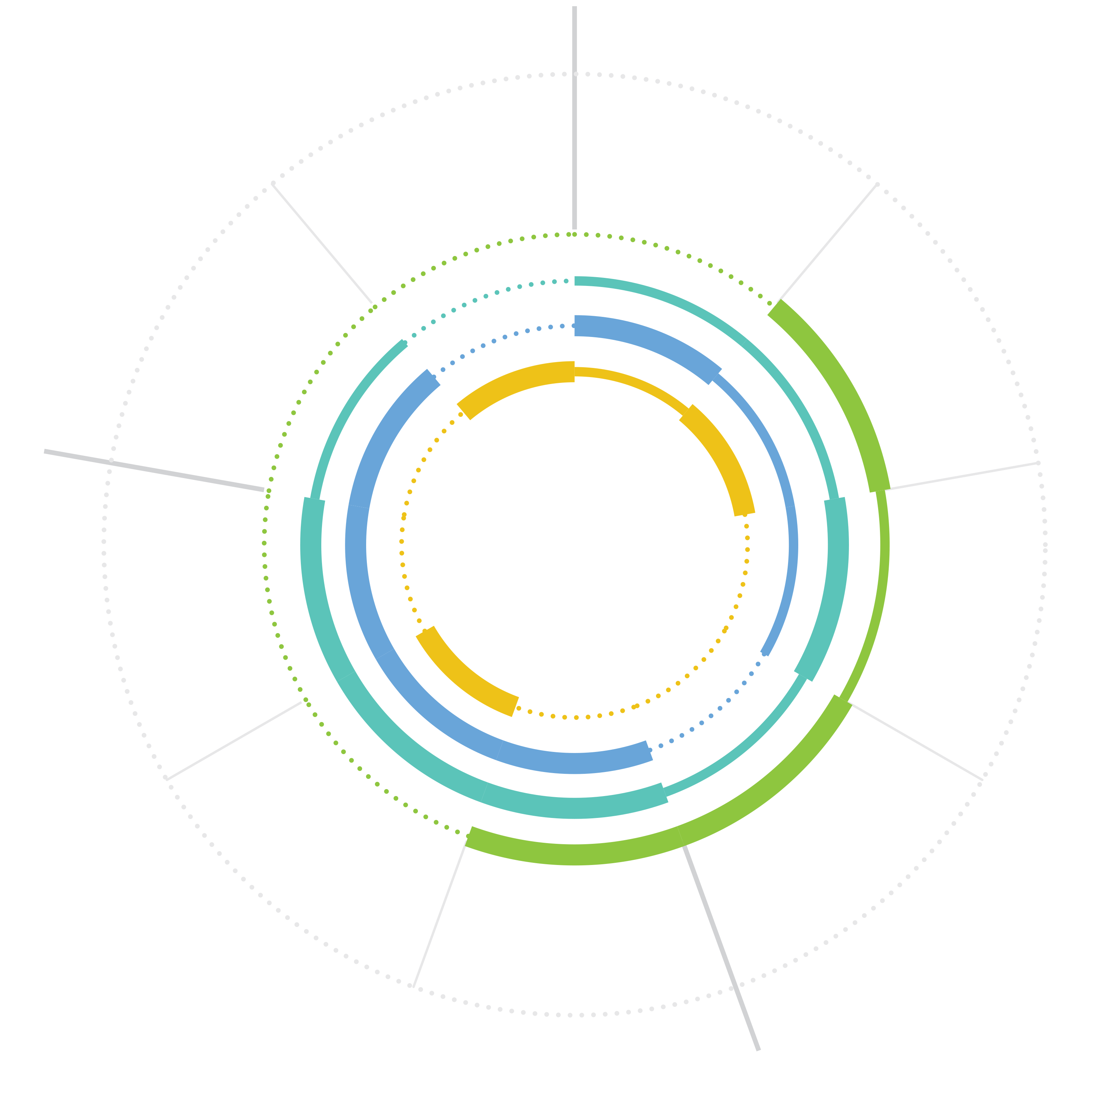



SPSS Users
OUTPUT
INPUT
Data Engineer
Architects how data is organized & ensures operability
Deliver and deploy model
Understand problem and domain
Ingest
data
Data Scientist
Communicate results
Gets deep into the data to draw hidden insights for the business. You can distinguish a technical and citizen data scientist
Create and build model
Explore and understand data
Business Analyst
Works with data to apply insights to the business strategy
Evaluate
Transform: clean
Transform: shape
Developer
Plugs into data and models & writes code to build apps
ANALYSIS
Notes:
This slide shows the data to insight lifecycle and what role (persona) is involved in what part of the process. The personas in the blue box are the target user roles for IBM SPSS.
Sometimes you will also read the following user roles: citizen data scientist, technical data scientist and business analyst. The main difference between a citizen data scientist and business analyst is described below. This distinction will become important as you are discussing SPSS in conjunction with Data Science Experience (DSX) → this will also be covered in more detail in a later section of this deck.
Citizen Data Scientist – has emerged as advanced analytics have become more accessible – these are individuals that are comfortable with data, they understand some but not all advanced techniques, and they are comfortable with statistical concepts and maybe even some predictive modeling as long as its guided and visual
Technical Data Scientists – is a reboot of actuarial science, deep math, statisticians, data miners, game theorists, and econometric specialists. While the code of data science has been around for a while, it has gotten easier to work with (Rstudio), easier to get (open source) and more powerful thanks to the community approach to development embraced by the open source community. These are the new rock stars that are versed in Python, Spark, R – but these individuals need the guidance of the business to be most effective

Slide 10





SPSS Use Cases
Evidence-based medicine
Improving patient care and satisfaction
Reducing costs through optimized allocation of resources
Measuring and improving patient outcomes
Human capital management
Acquiring, growing and retaining employees
Helping ensure optimal staff levels
Increasing performance, efficiency and engagement
Crime prediction and prevention
Identifying predictors of threat and fraud
Optimizing force deployment
Anticipating and visualizing crime hot spots
Supply chain management
Increasing visibility into virtually all areas of the supply chain
Decreasing downtime and unpredictability
Improving customer satisfaction
Process optimization
Improving accurate responses at the point of impact
Decreasing costs through operational efficiency
Transforming threat and fraud identification processes
Notes:
Predictive analytics enterprise solutions span multiple core business objectives and industries…For example:
Evidence Based Medicine in Healthcare
Predictive analytics are used to understand drivers for better health outcomes and patient satisfaction. They are also used to understand how best to allocate scare resources such as nurses and physicians.
For example, Ottawa Hospital
Capture the baseline response times to consult requests to reach a goal of <15 minutes
360-degree visibility to patient care
Automatic escalation of inadequate responses to consult requests
Business Challenge The Ottawa Hospital seeks to treat every patient like a loved one, and so needed a way to systematize and improve patient care procedures.
The Solution The Ottawa Hospital is implementing a collaborative Care Process Management system that uses advanced analytics and statistical modeling to help improve its staffing and better coordinate care based on actual patient needs. The solution improves accessibility to information as well as collaboration across the care team, reducing time now spent in trying to find data or even people within the hospital system.
In addition, scenario modeling and simulation help the hospital select the physicians who can provide the best and quickest response to ED consult requests, matching patient situation and provider skills
Human Capital Management
No area within an organization has more data than HR. Information on employees is captured in many ways – through the recruiting process and as part of an employee’s career and interaction with performance management systems and learning systems as well. By applying predictive analytics enterprise solutions to human capital management, organizations can begin to understand what makes employees successful and use that to acquire, grow and retain their most valuable asset – their people. At the same time, they can better understand their staffing needs and ensure they have the right resources, at the right time, in the right corporate structure to increase performance and efficiency while also maximizing employee satisfaction within the organization.
Crime Prediction and Prevention
Policing organizations worldwide have been turning to predictive analytics enterprise solutions to better protect their communities. They are using predictive analytics to better understand the patterns for threats and frauds – especially as criminals are becoming smarter and the amount of data available grows. By anticipating crime better, they can better allocate their resources and start anticipating where officer should be well in advance of the request for help.
For example, the Memphis Police was able to achieve a 30% reduction in serious crime overall, including a 36.8% reduction in crime in one targeted area; 15% reduction in violent crime; 4x increase in the share of cases solved in the MPD’s Felony Assault Unit (FAU), from 16 percent to nearly 70 percent; Overall improvement in the ability to allocate police resource in a budget-constrained fiscal environment
Supply Chain Management
Predictive Analytics Enterprise Solutions can help organizations use their data to better predict shortfalls in inventory and breakdowns in the process. This improves visibility and provides leaders with the ability to take corrective action faster – which decreases downtime and improves customer satisfaction.
For example, the Bammer Group a Manchester, England-based distributor, with more than 2,000 employees across 16 countries, turned to IBM to implement predictive analytics technology, helping them to reveal patterns and trends in organizational data and obtain crucial insight into how to manage stock levels more efficiently.
Results:
Streamline inventory saved £31.1 million in one year. Inventory turnover improved from 3.2 times at the end of 2008, to 3.7 times at the end of the first half of 2009.
Benefits:
IBM predictive analytics technology has helped the company dramatically streamline inventory by creating stock profiles based on customers’ buying patterns, enabling it to forecast more efficiently what stock is needed.
Process Optimization
The last example I’ll highlight – though this is not an exhaustive list and Predictive Analytics Enterprise Solutions can be applied to any number of areas – is Process Optimization. Predictive Analytics is typically considered a technology that is applied to people behavior – but it can also be applied to the process itself – the inputs, the outputs and the steps in between. By applying predictive analytics technology, organizations can improve the process itself – make smarter decisions at the point of impact and decrease costs of inefficiency. And it can help minimize process risk by predicting where threat and fraud is likely to occur to organizations can quickly close those loopholes before they have a detrimental impact on the business.
10

Slide 11
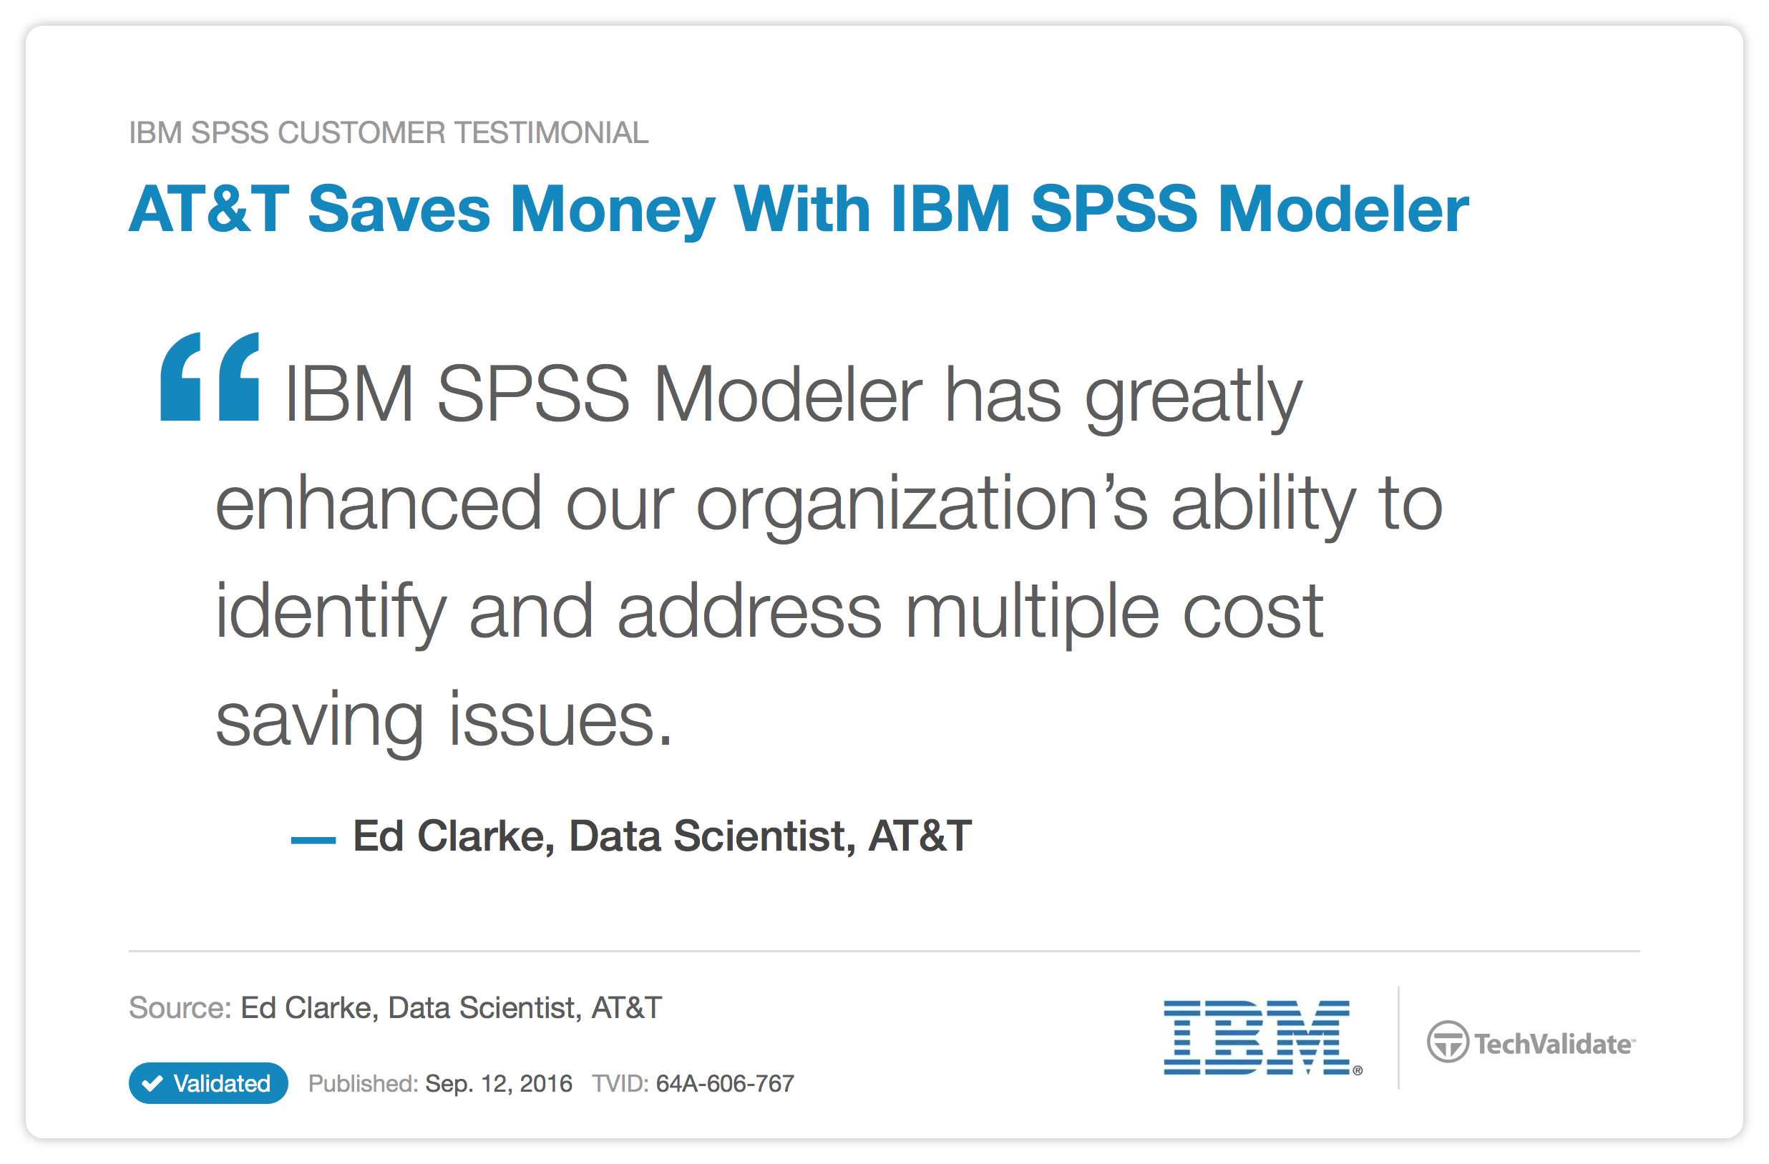
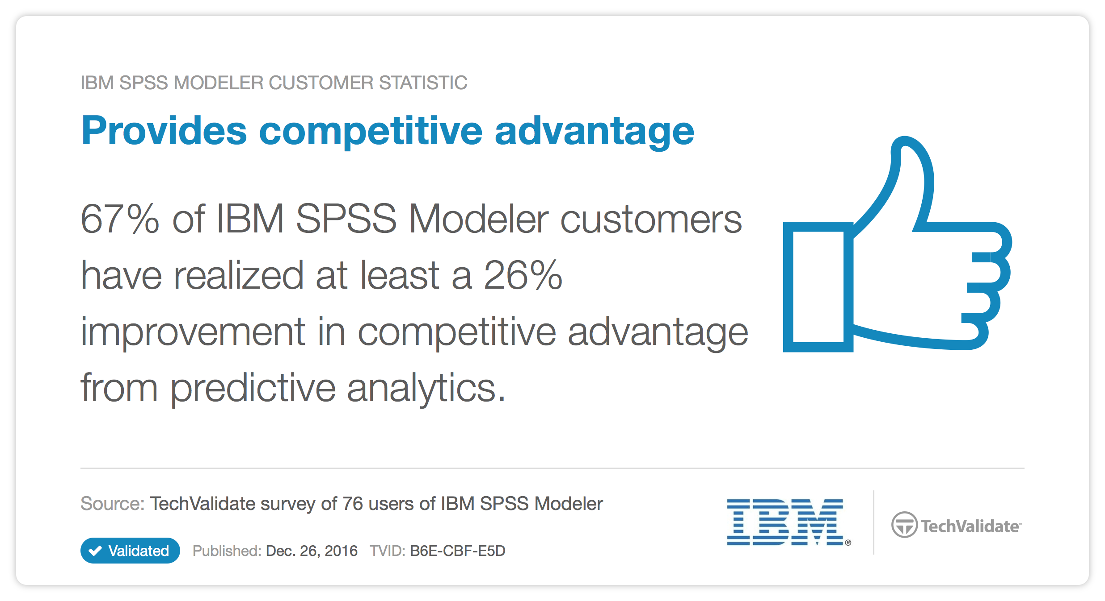
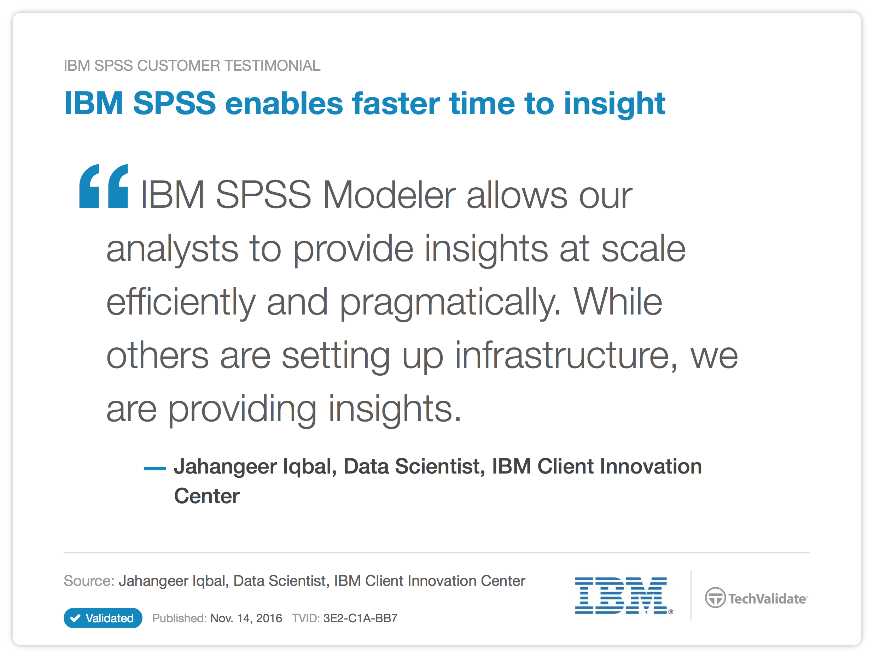
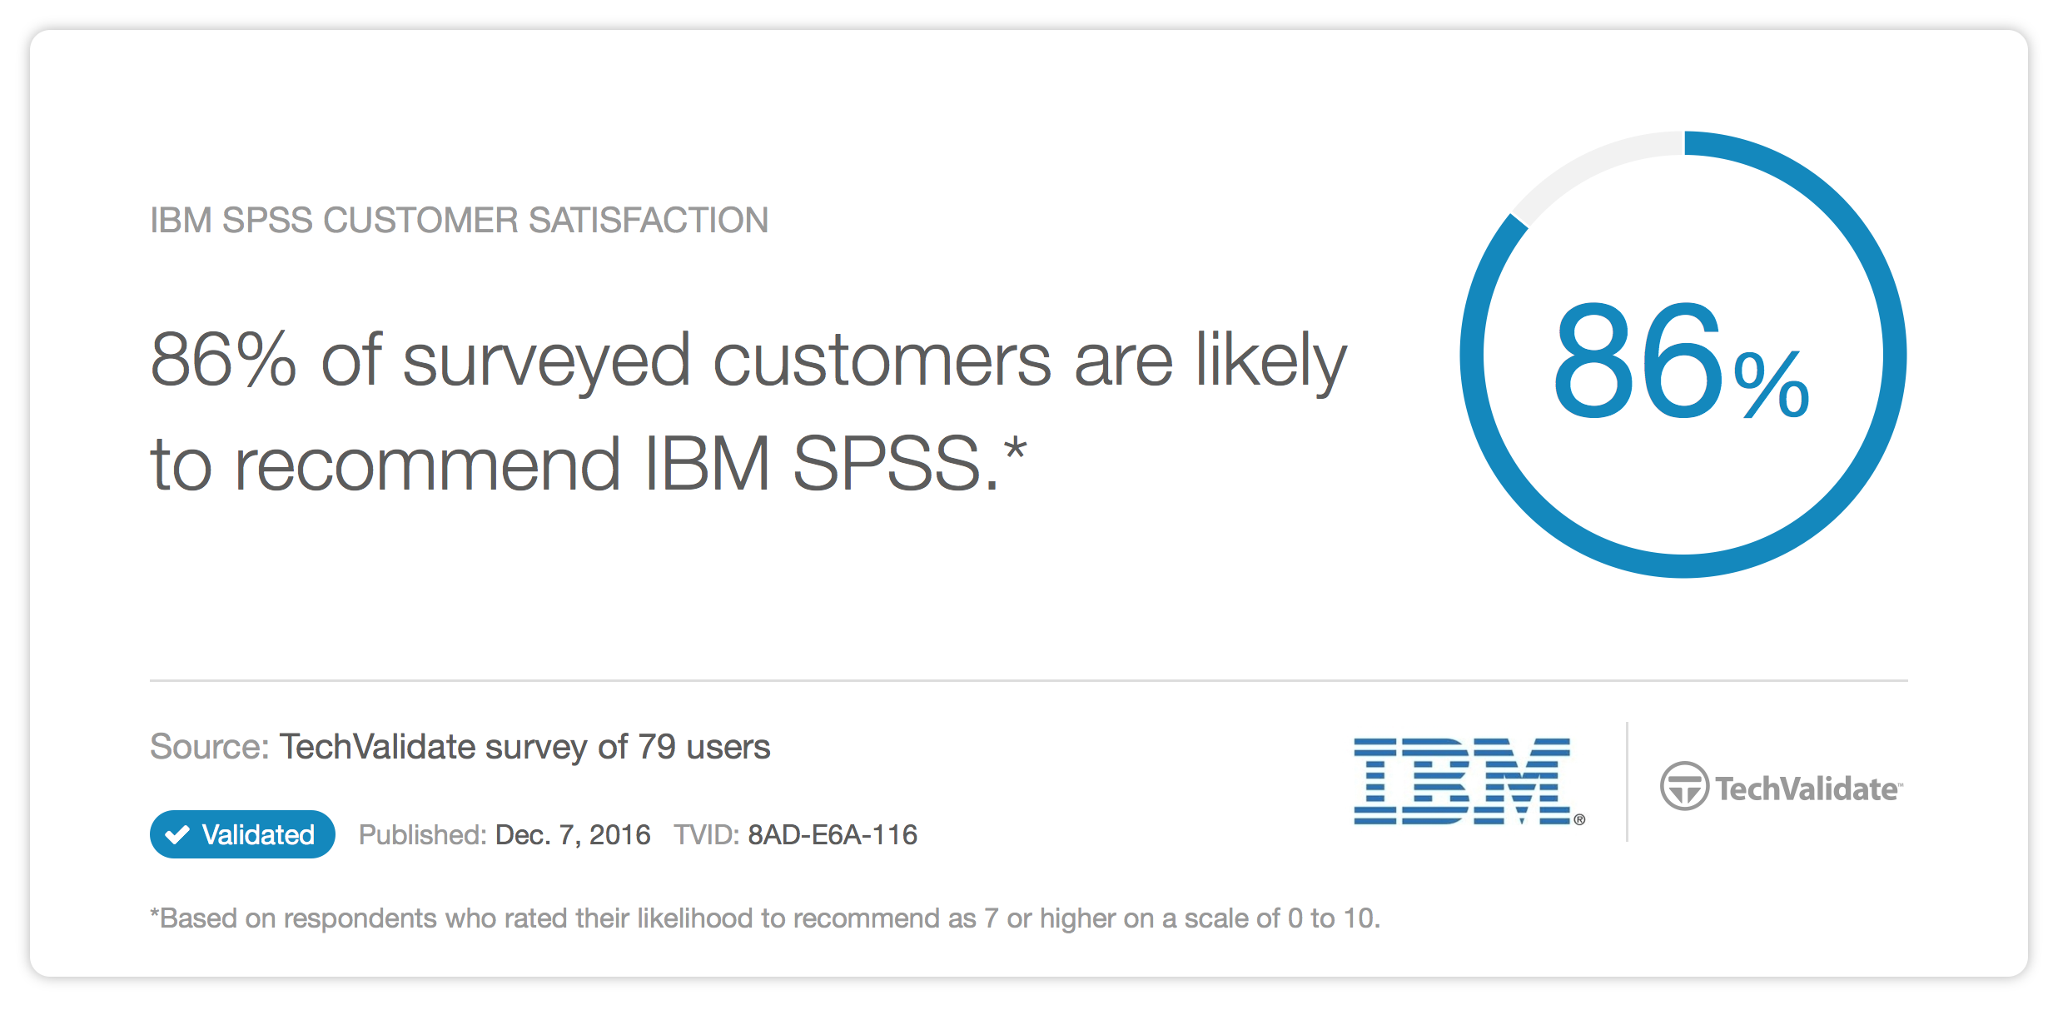
Organizations Using SPSS See Results
Notes:
Quotes and stats come from the TechFacts website and can be verified via the following links:
AT&T quote: https://www.techvalidate.com/product-research/ibm-cloud-data-services/facts/64A-606-767
Provides competitive advantage stat: https://www.techvalidate.com/product-research/ibm-cloud-data-services/facts/B6E-CBF-E5D
86% recommends SPSS stat: https://www.techvalidate.com/product-research/ibm-cloud-data-services/facts/8AD-E6A-116
SPSS provides faster time to insight quote: https://www.techvalidate.com/product-research/ibm-cloud-data-services/facts/3E2-C1A-BB7

Slide 12














IBM SPSS Data Science Platform
How does it work?
ALL Data
(Structured, Unstructured, Streaming)
All Decisions
(People, Systems, Strategic, Operational, Real-Time)
Data Preparation
Analytics at Scale
Insight to Action
Data models
Data connectors
Data Wrangling
Predictive models
Machine Learning
Statistical Analysis
Decision Optimization
Real-Time Scoring
Optimized Decisions
APIs & services
Dashboards / Interactive apps
Learn
Notes:
In this slide you can see a view of IBM’s platform for Predictive Analytics, called IBM SPSS, depicted as an analytical workflow. An analyst who is using SPSS will usually work from left to right to get from data to a (better) decision/ outcome. Here are the steps (s)he usually takes
Gathering the requirements for the business problem that needs to be solved (not visible on this slide)
Collecting ALL data
Data preparation. This is usually the most time consuming part of an analytical workflow and can take up to 80% of an analyst’s time
Building and testing predictive models
Share the outcomes through a dashboard or report.
Deploy the predictive model in a business process, application (e.g. IBM Decision Optimization) or dashboard
The 2 major products in the IBM Predictive Analytics portfolio are IBM SPSS Statistics which can be used for statistical hypothesis testing and IBM SPSS Modeler which is the desktop data mining workbench which enables individuals to build predictive models. In this slide you can see what this set of products can be used for. We’ll explain the flow from left to right.
All Data
IBM SPSS is able to tap into virtually any data source from structured (for example, “classic” databases such as IBM DB2), to unstructured (such as social media data) to streaming data (such as IBM InfoSphere Streams and Spark)
Data preparation
Any analyst can tell you that they spend approx. 80% of their time on data preparation. Data preparation can encompass various activities like data cleansing, data merging and doing manual work with data in Excel. SPSS has connectors to many data sources and offers tremendous capabilities to prepare the data (also knows as data wrangling) before it is ready to be modeled
Analytics at Scale
With SPSS you can build predictive models and perform statistical analysis. The predictive models are dynamic and “learn” with every piece of data you put into it, this is nowadays commonly referred to as Machine Learning. Predictive Models can also be deployed in operational business processes so you can make the optimal decision at the point of impact. A good example of this would e.g. be the seamless integration with IBM Decision Optimization (SPSS)
Insight to Action
Predictive models can be embedded in (operational) business processes and can provide real-time scoring information (e.g. credit check). Also these models can be exposed as services so they can be very easily integrated in other IBM technologies like IBM Bluemix and IBM Cognos Analytics.
All Decisions
The power of SPSS is that it can democratize predictive analytics and make it available to every person and process in the organization and impact all decisions in real-time
In summary here are benefits of IBM SPSS Predictive Analytics
Easy to embed in business processes
Easy access for business users
Openness and extensibility
Power for business transformation
Guided workflow approach to predictive analytics, grounded in industry best practices called CRISP-DM (Cross Industry Standard Process for Data Mining)

Slide 13




IBM SPSS Modeler – Code-Optional Data Science
Open
and extensible
Deployment
at scale
Empower every user
Simplicity without sacrifice
Code optional, open to open source
Predictive everywhere
Notes:
This is in essence the simplicity for the business user – without sacrificing the depth of functionality that an advanced analytical user needs
Some of the features that make IBM SPSS Modeler unique are:
Automated model creation. SPSS Modeler can select which predictive modeling technique fits best to solve your business problem. Especially novice modelers sometimes get overwhelmed with the magnitude of predictive models that are supported. This will save time and increase the accuracy of your predictive model.
Automatic data preparation. Analysts spend on average 80% of their time on preparing the data (aka data wrangling or data munging). SPSS Modeler has built in functionality that can automate data preparation so that’ll save time for the analyst/ modeler which (s)he can spend on more value adding activities.
Advanced analytical capabilities are built in. Capabilities like text analytics, entity analytics, scripting and support for open source (R, Python) are features which will satisfy modelers with advanced analytical user needs.
Infinitely complex workflows. SPSS Modeler has a very intuitive graphical user interface (GUI) which makes the design of predictive analytical workflows very easy to create, maintain and manage. The graphical workflows will help you manage your most complex workflows and will act as a great communication tool when you discuss your analytics project with your stakeholders
Open and extensible – Code optional, open to open source. SPSS Modeler is open by nature and is code optional. The beauty of SPSS Modeler is that coding is optional but if it is needed you can easily bring the code in the predictive models. IBM is embracing and extending open source like R and Python. See the IBM SPSS and Open Source section of this deck for more detailed information
Deployment at scale – Builfing predictive models only makes sense if you deploy them so the business can take better decisions. SPSS predictive models can be deployed at scale. See the IBM SPSS Predictive Analytics deployment section in this deck for more detailed information

Slide 14
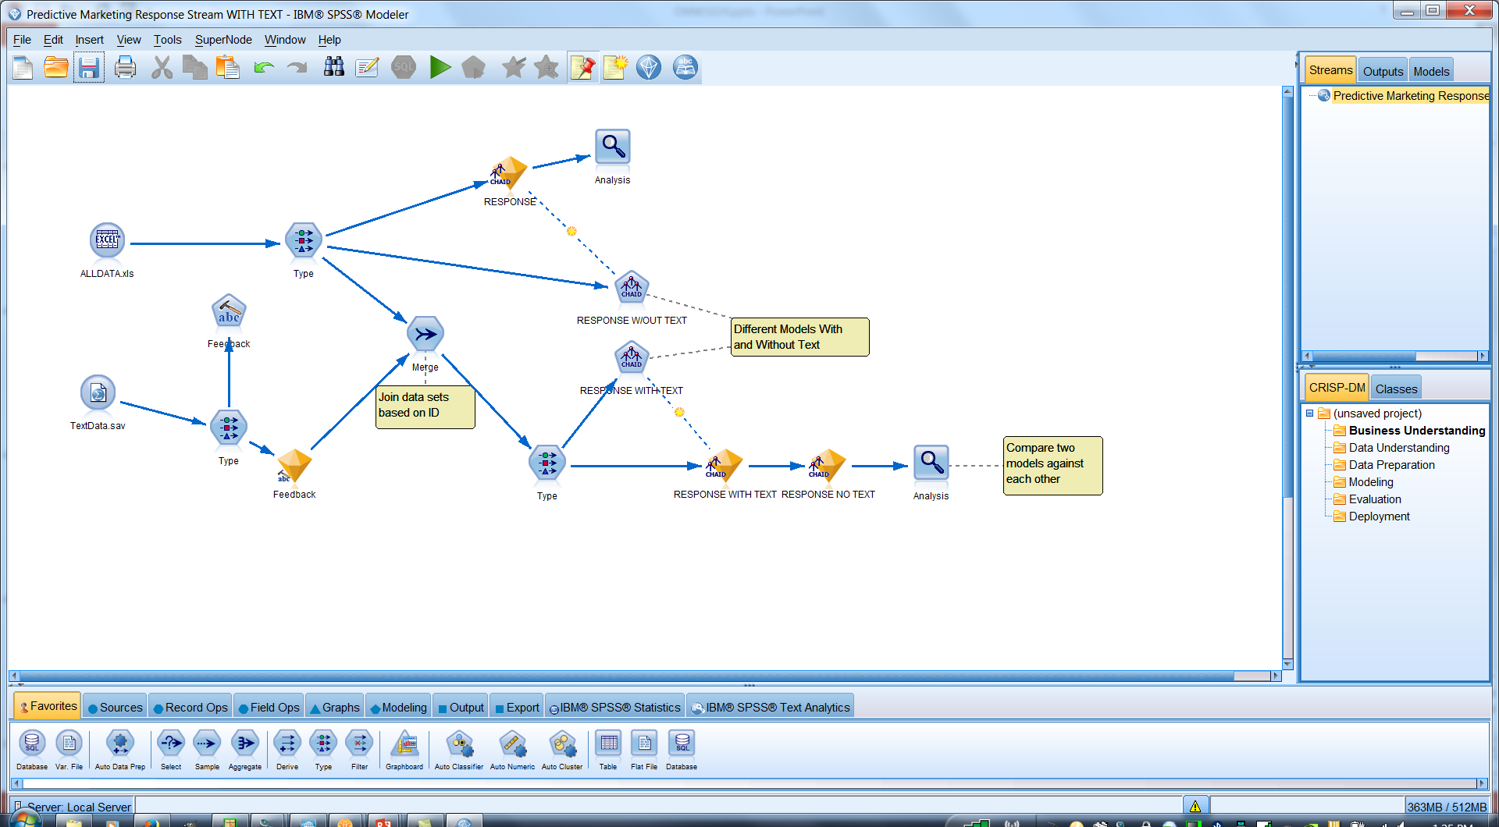
IBM SPSS Modeler: At A Glance
Flexible adoption and configuration
On premises
Cloud
Hybrid
Bluemix
Modeler Gold
Scale from personal usage, point solution(s) to enterprise deployment
Comprehensive predictive analytics platform
Identify patterns to generate predictive intelligence and improve outcomes
Access a range of advanced analytics; decision management, text, entity, social network analysis and optimization
Notes:
I’d like to now introduce IBM SPSS Modeler. At a high level it is:
A comprehensive predictive analytics platform
For all types of users – from a business user just learning predictive analytics to a data scientist performing sophisticated, customer data mining projects
It includes multiple deployment options, optimization and decision management capabilities
Within a visual interface with build-in guidance
And supports structured and unstructured data (text analytics, entity analytics, social network analysis)
Can be deployed on a single desktop or integrated within complex operational systems
And that brings predictive intelligence to a single user, to an entire enterprise, and more
Let’s walk through some of the key features….

Slide 15
Exercise: Predictive In 20 Minutes
Goal:
Identify who has responded to a marketing campaign
Approach:
Use a data extract from a CRM
Prepare data for modeling
Define which fields to use
Choose the modeling technique
Automatically generate a model to identify who has responded
Review results
Why?
To save marketing cost and increase marketing response, identify those likely to respond and focus marketing efforts on those prospects.
Notes:
Let’s begin with a simple example designed to familiarize you with the application.
We are a bank who is marketing a product directly to customers. We have extracted a sampling of data from our customer relation management system. This data contains information about our customers, their buying behavior, and more. There is also a flag to indicate if they have responded to recent marketing campaigns.
Exercise – Predictive in 20 Minutes
<Instruct the students to use the workbook they received to follow along as you go step-by-step through the exercise. Come back to this slide after the exercise.>

Slide 16

Spss modeler overview continued
Notes:
As part of our wrap up, I’d like to ask you to think about how you would apply this to YOUR business.
[instructor: lead the conversation and solicit input as needed]

Slide 17
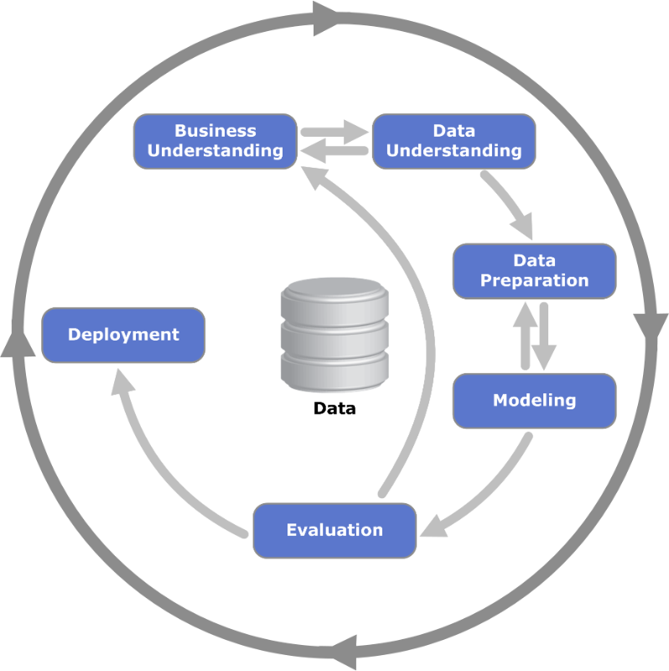
CRISP-DM: Cross Industry Standard Process for Data Mining The Traditional Data Science Workflow
Notes:
“CRISP-DM” stands for “Cross Industry Standard Process for Data Mining” – it is a generally accepted data science workflow.
It is perhaps a bit dated (or lacking in detail on the deployment phase), but still very relevant. Although certain terms and techniques go in and out of fashion, the overall idea remains much the same. Every successful data science journey is tied to some business outcome. There is an opportunity to use analytics to somehow squeeze more out of your margins or find new avenues for profitable top-line growth.
The cycle starts with the Data Science team working with a Line of Business to better understand the data that resides in the organization today, as well as any additional data capture needs for shoring up their data assets. As the data understanding becomes clear, the Data Science team will move on to the first iteration of their analysis. Data preparation (such as cleaning) takes up about ~80% of the time in this process.
The goal is to prepare the data so that it is easily consumable by a modeling algorithm. All modeling algorithms are developed based on some underlying theory, which assumes that the data was generated from some underlying process. Therefore, the Data Scientist often performs various types of techniques in order to improve the features that are used in the modelling process. Better features enable the machine learning algorithm to build a better model.
After a model is trained (or during, if you are using some form of hyper-parameter tuning) several metrics are used to determine model effectiveness. The goal of model building is to build a model that will generalize well to unseen data (coming from the same or similar sources). Once the Data Scientist is happy with the effectiveness of their model, they will deploy their predictive model.

Slide 18
CRISP-DM: Cross Industry Standard Process for Data Mining The Traditional Data Science Workflow
Business Use Case
Understanding Attributes
Data Cleaning
Feature Engineering
Transformation Set
Descriptive Statistics
Clustering
Model Coefficients
Machine Learning
Prediction Accuracy
Confusion Matrix
Cross Validation
Notes:
If we drill down a little bit, we can see all of the major steps that a Data Scientist performs. This slide is really important for understanding what a Data Scientist does.
Once the Data Scientist has an understanding of their data and has sufficient data to get started, they move on to the “data preparation” phase. This phase is very time consuming. A Data Scientist spends about 80% of their time here, performing tasks such as data cleaning and feature engineering. These steps are crucial, especially if a predictive model is going to be built. Deriving competitive advantage through data is predicated on having good data.
During and after cleaning the data, the Data Scientist generally performs exploration – such as descriptive statistics to get an overall feel for the data and clustering (i.e., unsupervised learning) to look at the relationships and latent structure of the data. This process is often iterated several time until the Data Scientist is satisfied with their data set.
The model training stage is where machine learning is used in building a predictive model. This model is trained and then evaluated by “model diagnostics” – statistical measures such as prediction accuracy, sensitivity, specificity, etc. Once, the model is deemed sufficient, the model along with the transformation set is used in deploying the model for scoring on unseen data.
As you can see, model training is typically performed on historical data, whereas model scoring is typically applied to production data.

Slide 19


Analytical Techniques in IBM SPSS Modeler
Technique | Algorithms | Usage
Classification (Or Prediction) | Autoclassifiers, Decision Trees, Logistic, Support Vector Machines, Time Series | Predict Group Membership (e.g., Will This Employee Leave?) Or a Number (e.g., How Many Widgets Will I Sell?)
Segmentation | Autoclusters, K-Means, Anomaly Detection | Classify Data Points Into Groups That Are Internally Homogenous and Externally Heterogeneous, Identify Cases That Are Unusual
Association | Apriori, CARMA, Sequence | Find Events That Occur Together Or In a Sequence Market Basket
Geospatial | Space-Time Boxes | Ability to Improve Model Accuracy (for Any Model Type) By Including Inputs Derived From Geospatial Data Sources
Automated | Autoclassified, Autonumeric, Time Series, Clustering | Automatically Find the Right Algorithms Based On Data and Outcome to Create An Ensemble Model
Simulation | Monte Carlo | Run Different Scenarios to Identify Which Is Best From Historical Data Or Generated Data
Specialized | Text Analytics, Entity Analytics, Social Network Analysis | Improve Overall Model Accuracy
In-database | Netezza, DB2, Oracle, Microsoft | Provide User Friendly Interface On Top of Vendor Algorithms
Open Source | R/Spark/Python | Utilize Open Source Algorithms Within Modeler UI. Enhance By Easily Building Custom Dialogs (or downloading from community)
A single analysis project may include multiple techniques
Notes:
IBM SPSS Modeler has a very broad range of modeling algorithms, grouped by their usage.
Classification, Segmentation and Association
Classification includes techniques such as decision trees, regression or neural networks and is typically used to predict group membership. For example, will this employee leave? Or to predict a customer value.
Segmentation algorithms are used to put data into groups and predict group membership for new cases. Association finds events that occur together or in a sequence. These techniques are used for market basket analysis where users are looking to see what products are bought together and in what order.
There are also some automated modeling procedures which enable users to quickly generate multiple models and evaluate their performance before selecting which is the most appropriate to use in each case.

Slide 20
IBM SPSS and
Open source
Notes:
As part of our wrap up, I’d like to ask you to think about how you would apply this to YOUR business.
[instructor: lead the conversation and solicit input as needed]

Slide 21


IBM SPSS and Open Source
Embrace
Extend
Facilitate
First R, then Python, now Spark
Make coding optional
Make it massively useful
Notes:
SPSS embraces, extends and facilitates the use of open source such as R, Python and Spark
We added support for R, then Python and now Spark
We extend the use of open source within the analytical team by making coding optional – not just for analytics, but for open source
And we facilitate deployment of open source – we make it massively useful – and that I had addressed earlier

Slide 22
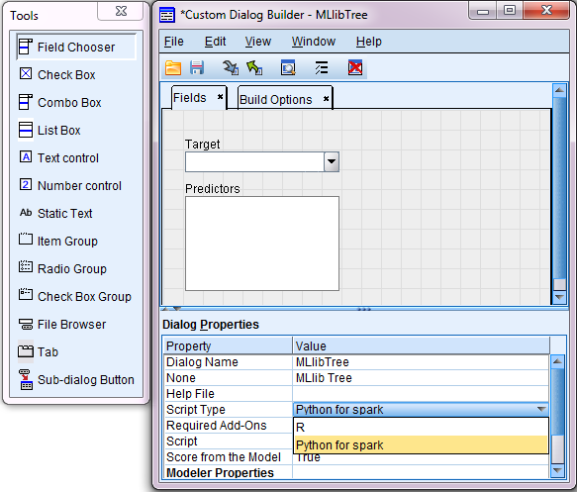
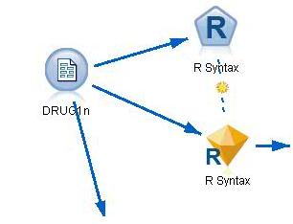

Extend Using Spark, Python Or R
Use script within your modeling stream
Create extensions for novice users to exploit
R, Spark’s machine learning library (Mllib)
Other common Python libraries
e.g.: Numpy, Scipy, Scikit-learn, Pandas
Abstracting code behind a GUI makes code usable for non-programmers
Notes:
Users can leverage open source directly in a stream in SPSS Modeler along-side native capabilities
They can also put open source behind dialogue boxes and create new functionality for those that don’t know or want to code
This makes innovation more accessible and re-usable – and also create repeatability. Having this repeatability can provide confidence in the analysis for the information consumer – having a way to enforce best practices and a common approach makes the results more compare-able and certainly more defendable and this is something that is vital in some businesses with high levels of regulation – financial services, government entities, healthcare

Slide 23
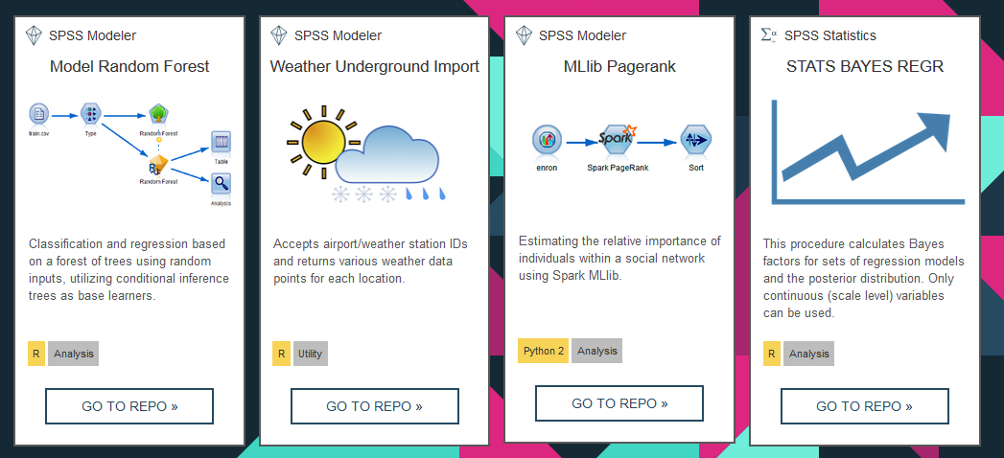
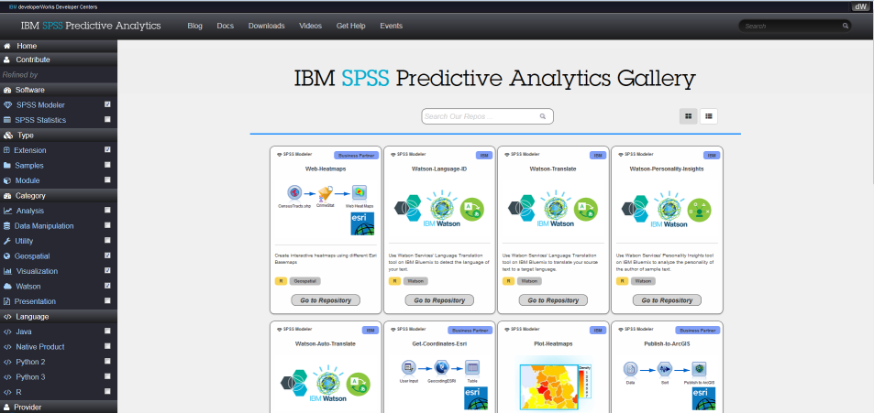
Growing Catalogue of Predictive Extensions
https://developer.ibm.com/predictiveanalytics
Notes:
There is a growing catalogue of what we call extensions – these are additional capabilities that can be downloaded for free from our community (see link at the bottom of the slide). You can take advantage of these to see the code underneath – which may be Spark or R or Python.
There are extensions available for SPSS Modeler and SPSS Statistics

Slide 24

Break - please return in 10 minutes
Notes:
Congratulations! Jane to add…
To celebrate, lets take a short 15-minute break. When we come back, we will look at one approach to data mining as well as walk through a few more hands-on exercises.

Slide 25

Exercise 2: Find Patterns And Groups
Goal:
Create segments of customers
Approach:
Merge disparate data sources
Define which fields to use
Automatically generate a model to group customers
Apply business terms to new groups
Export newly created groups to database
Why?
Better customer understanding (demographics, socio-economic etc)
Tailored messages for each group/segment
Personal and more relevant for consumers
Notes:
For this exercise, we are a retailer that wants to increase our share of our customer’s wallet through successful cross-sell opportunities. To do this, we want to identify which products are sold together so we predict with certainty that if we extend an offer for one of these products that it will be accepted.
We have transactional data – at the customer level – to help us identify which products are purchased together and which products aren’t purchased together. These insights and taking action on these insights through marketing promotions will enable us to increase our customer’s basket size and, ultimately, our revenue.
Exercise – Association Modeling
<Instruct attendees to open their workbooks and follow along with the exercise. Return to the presentation when the exercise is complete.>

Slide 26


Find Patterns and Groups
Understand the Past, Predict the Future
Deploy Insights on new projects
Classify customers into groups based on underlying characteristics
Model response to marketing offers using historical data
Leverage models to create insights on new customers

Slide 27
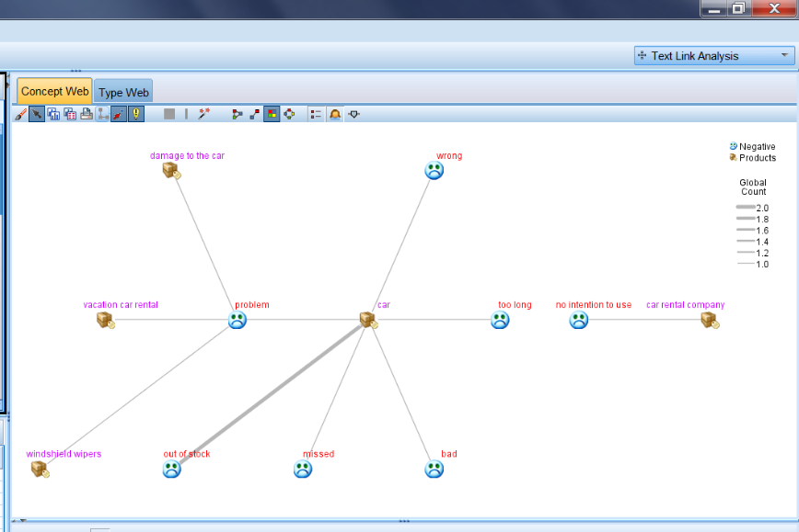
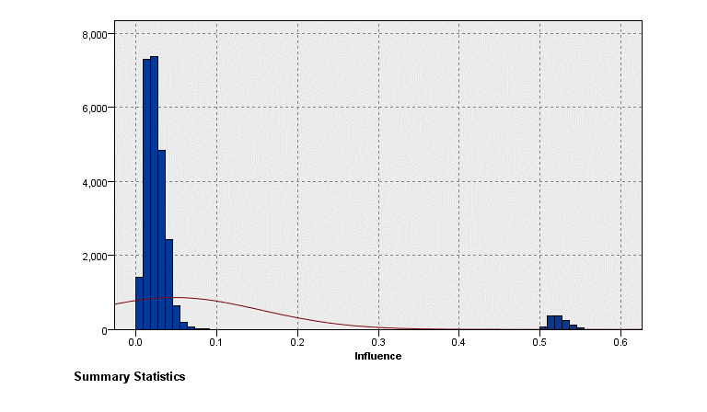
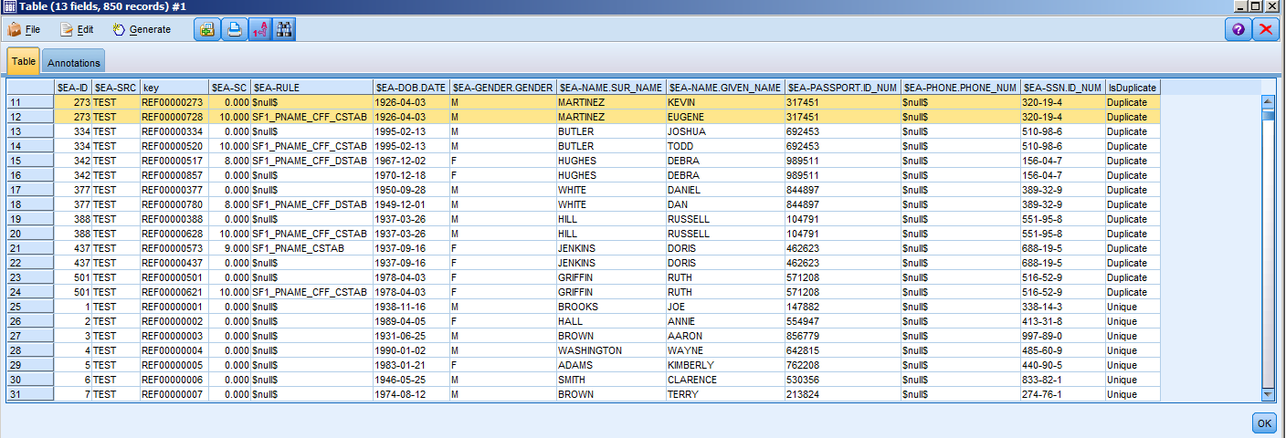
Uncovering Patterns In Unstructured Data
Text Analytics
Natural Language
Sentiment Analysis
Entity Analytics
Disambiguate identity
People, places, things
Social Network Analysis
Uncover relationships
Find leaders and followers
Notes:
Aside from the ability to handle structured data, Modeler includes the ability to use text and social media data. Text from multiple sources can be structured and used in models through text analytics, which uses natural language processing and includes sentiment analysis. Entity analytics can disambiguate identities – commonly used for people but can also be used for other entities (places, things, transactions, etc.). Social Network Analysis can uncover relationships between people within a social network – and is used to (for example) find social leaders and social followers

Slide 28

The Importance Of Text
Because people communicate with words, not numbers, it has become critical to be able to mine text for its meaning and to sort, analyse, and understand it in the same way that data has been tamed. In fact, the two basic types of information complement each other, with data supplying the “what” and text supplying the “why”.
Source IDC: “Text Analytics: Software’s Missing Piece?”
Notes:
The reason text is important is not all our organization’s data is structured. In fact, for many organizations, more of their data is unstructured than structured.
Examples of unstructured data are responses from surveys, call centre notes, maintenance logs, claims forms...any documents that may contain data you want to analyse. Unstructured data often provides the reasoning why someone was dissatisfied or bought a product or service. By combining the “why” with the “who” and “what,” we are able to see a more complete picture of the situation and improve the accuracy of the models being produced.

Slide 29
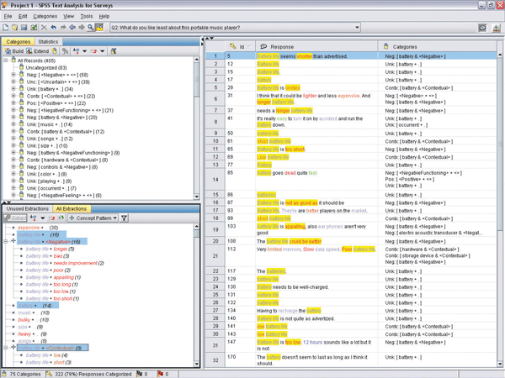
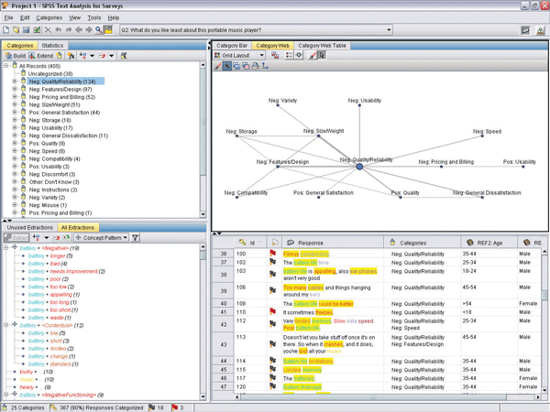
Text Analytics
Uses natural language processing heuristic rules and statistical techniques to reveal conceptual meaning in text
Extracts concepts from text and categorizes them
Makes unstructured qualitative data more quantifiable, enabling the discovery of key insights from sources such as: -Documents -Survey responses -Call center Notes -Social Media -Web Pages
29
Notes:
29
29
29

Slide 30
Exercise 3: Understand The Past, Predict The Future
Goal:
Identify who is likely to respond to a marketing offer
Approach:
Use a data extract from a CRM
Extract concepts from the open ended comments in a customer survey
Define which fields to use
Choose the modeling technique
Automatically generate a model to identify who is likely to respond
Review results
Why?
Target those likely to respond to offers to increase revenue, cut costs
Using unstructured data improves modeling accuracy and provides more insight
Notes:
For this exercise, we are trying to increase our marketing ROI by better targeting the customers who will most likely respond to our marketing campaign. Though precise target instead blasting our entire customer base, our marketing should yield better response rates while reducing the cost of our marketing campaign.
To do this, we have an extract of customer data and we want to put those customers into groups. Instead of manually specifying who belongs in which group, the segmentation algorithm will automatically put people into groups based on their characteristics. Those with similar features will be put into the same groups and those with dissimilar features will be put into separate groups.
Exercise – Segmentation Modeling
<Instruct attendees to open their workbooks and follow along with the exercise. Return to the presentation when the exercise is complete.>

Slide 31
Find Patterns and Groups
Understand the Past, Predict the Future
Deploy Insights on new projects
Classify customers into groups based on underlying characteristics
Model response to marketing offers using historical data
Leverage models to create insights on new customers

Slide 32
Exercise 4: Deploy Insights On New Projects
Goal:
Leverage predictive insights to score new consumers
Approach:
Use new customer records who have never received an offer
Leverage the text extraction and classification models used in exercise 3
Automatically generate scores of who is likely to respond
Review results
Deploy results for use by marketing team
Why?
Create models on large populations for robust, representative results, and easily score smaller record batches when necessary, on-demand.
Apply consistent and seamless methodology over many model scoring iterations, ensuring quality control.
Notes:
For this exercise, we are trying to increase our marketing ROI by better targeting the customers who will most likely respond to our marketing campaign. Though precise target instead blasting our entire customer base, our marketing should yield better response rates while reducing the cost of our marketing campaign.
To do this, we have an extract of customer data and we want to put those customers into groups. Instead of manually specifying who belongs in which group, the segmentation algorithm will automatically put people into groups based on their characteristics. Those with similar features will be put into the same groups and those with dissimilar features will be put into separate groups.
Exercise – Segmentation Modeling
<Instruct attendees to open their workbooks and follow along with the exercise. Return to the presentation when the exercise is complete.>

Slide 33
Portfolio
Implementation and deployment
Notes:
As part of our wrap up, I’d like to ask you to think about how you would apply this to YOUR business.
[instructor: lead the conversation and solicit input as needed]

Slide 34
Our Portfolio: Power Behind And Across Your Firewall
Unified Governance
Hybrid Data Management
Data Analytics & Visualization
Data Science
& Machine Learning
Enable better insight and compliance across all data
Unify the approach to data and content on the path to cloud
Empower all to make data-driven decisions quickly and easily
Embrace new ways to develop insights and streamline operations
Open Source: Hadoop, Spark & more
Commit to openness—for speed and innovation
Notes:
IBM delivers the capabilities you need—for hybrid data management, data science and machine learning, data analytics and visualization, and unified governance, with a commitment to open source—to give you the power, convenience and economics you need, both behind and across your firewall.
IBM provides rich data and analytics services for private cloud environments. With a complete portfolio for you to leverage behind your firewall, spanning Advanced Analytics, Open Source, Self Service Data,& Repositories , as well as Data Governance.
We provide:
- Cloud features, behind your firewall
-Data residency
-Your security architecture
From an Advanced Analytics perspective, we have the most comprehensive set of solutions from AI to Predictive Analytics to Decision Optimization to the latest in Machine Learning.
According to Gartner in ten years virtually every application & service will incorporate AI.
IBM Machine Learning allows data scientists to automate the creation, training and deployment of operational analytic models that will support:
IBM Machine Learning is now available on z/OS and will be available for other platforms in the future,
Open Source has become part of our DNA, with our long term commitment to Spark and Hadoop
Enterprises across the globe now look to open source software to support mission critical, customer-facing workloads (Source: IDC, Open Source Powers Enterprise Digital Transformation, April 2016)
We are platform agnostic and offer a full range of Repositories to address your content and data warehousing needs
IDC identifies IBM as a Leader in Database Management Software
Unified Governance is critical going forward to ensure a single version of the truth, and IBM is an established leader in data governance and data integration

Slide 35
IBM’s Analytics Tools
What happened?
IBM Cognos Analytics
Descriptive
Get in touch with reality, a
Single source of the truth, visibility
What is our plan?
Why did it happen?
IBM Planning Analytics
IBM Watson Analytics
Planning
Diagnostic
Planning, budgeting, and
forecasting
Understanding why something
happened is a critical step
What should we do?
What will happen next?
IBM ILOG CPLEX
IBM SPSS
Prescriptive
SPSS
Predictive
Understand the most likely future
scenario and its business implications
Notes:
Leveraging data and driving better decision and outcomes should be the goal of your analytics strategy. Choosing how and where to start, and the right tools for the job, are often a difficult decision. While you could really start anywhere, we believe that gradually moving up this kind of maturity curve and layering on analytic capabilities that build upon one another is a sound approach. Starting with descriptive analytics, through the use of enterprise analytics capabilities, to disseminate trusted and key information across the organization (the “what”). Moving on to diagnostic analytics, which help you understand the “why”. Building upon that, with predictive analytics, to help make the “why” more actionable, and deployable. Followed by prescriptive analytics, which leverages the layers below to provide optimization, and efficient and effective actions.
IBM’s analytics portfolio has been designed strategically to support this progression, providing tools that are integrated, which complement one another, with the reuse of technology throughout. This started back in 2008 with the significant acquisitions of Cognos and SPSS. This is not a new strategy – we’ve worked through the challenges of integrating different cultures and software as a result of acquisitions, and have arrived at this complete set of tools that can truly help organizations progress along this analytics maturity curve.

Slide 36
SPSS Modeler Editions
Edition
Deployment
Techniques Capabilities Enhancements
Modeler Personal
Desktop Only
Classification Segmentation Association
Modeler Professional
Desktop/Server Hybrid
Classification Segmentation Association
Modeler Premium
Desktop/Server Hybrid
Classification Segmentation Association
Text Analytics Entity Analytics Social Network Analysis
Modeler Gold
Desktop/ Server/ Cloud/ Hybrid
Classification Segmentation Association
Text Analytics Entity Analytics Social Network Analysis
ADM C&DS
Notes:
Modeler Gold includes Modeler Premium + Collaboration & Deployment Services + Analytical Decision Management
Modeler Premium includes Modeler Professional +Text Analytics + Entity Analytics + Social Network Analysis
SPSS Modeler Gold Provides organizations with the ability to build and deploy predictive models directly into the business process to help people or systems make the right decisions each time. This is achieved with Decision Management which combines predictive analytics with rules, scoring and optimization within an organization's processes and operational systems to deliver recommended actions at the point of impact.
SPSS Modeler Premium Provides a range of advanced algorithms and capabilities including text analytics, entity analytics, social network analysis and automated modeling and preparation techniques to address a multitude of business problems and analytic requirements on almost any type of data.
SPSS Modeler Professional Provides a range of advanced algorithms, data manipulation and automated modeling and preparation techniques to build predictive models and uncover hidden patterns in structured data.
Modeler has a very broad range of modeling algorithms, grouped by their usage.
Classification, Segmentation and Association
Classification includes techniques such as decision trees, regression or neural networks and is typically used to predict group membership. For example, will this employee leave? Or to predict a customer value.
Segmentation algorithms are used to put data into groups and predict group membership for new cases. Association finds events that occur together or in a sequence. These techniques are used for market basket analysis where users are looking to see what products are bought together and in what order.
There are also some automated modeling procedures which enable users to quickly generate multiple models and evaluate their performance before selecting which is the most appropriate to use in each case.

Slide 37
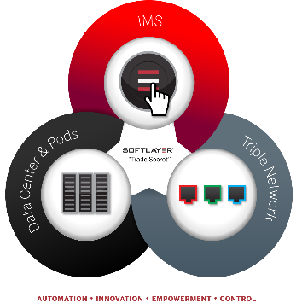






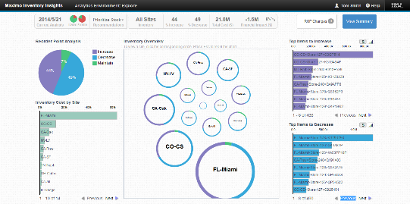







Flexible deployment
Flexible Deployment Options, Including Cloud, Supported By An Infrastructure-agnostic Platform
Flexible
Integrated With IBM’s High-performance Systems Built for Big Data Analytics
Integrated
Embedded Into Operational, Mobile and/or Cloud-based Applications
Embedded
Notes:
Transformation delivery to support new IT economies
Talk Big Data, Cloud, Optimization etc.

Slide 38
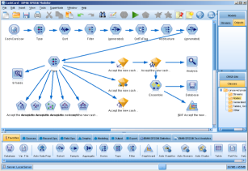
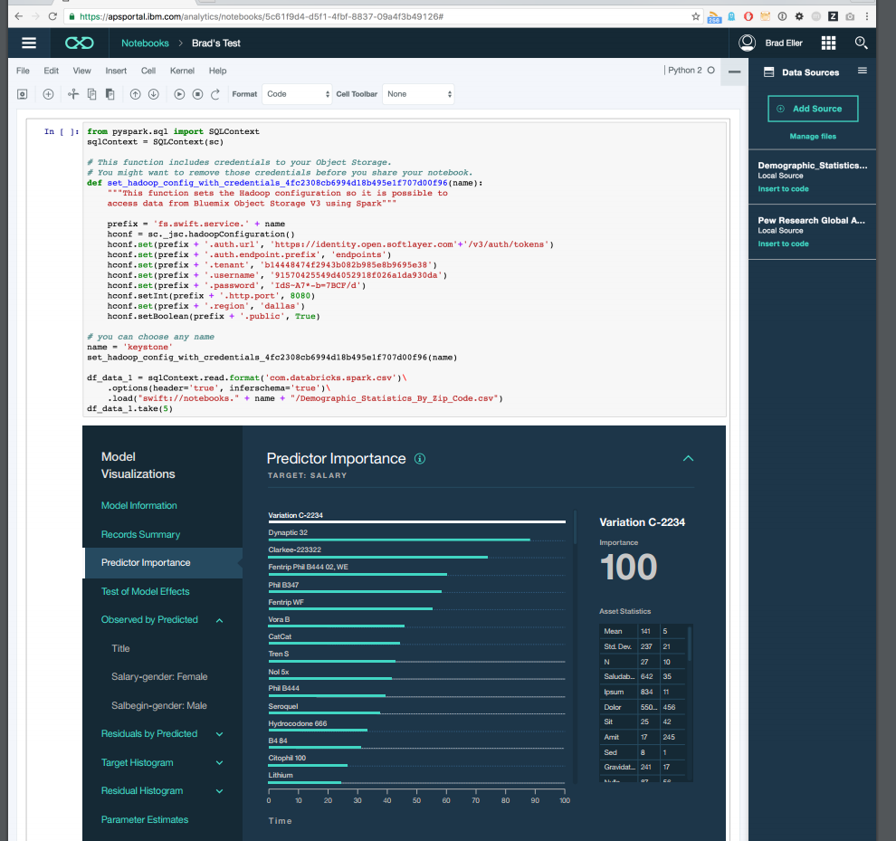
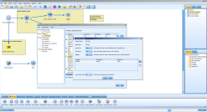
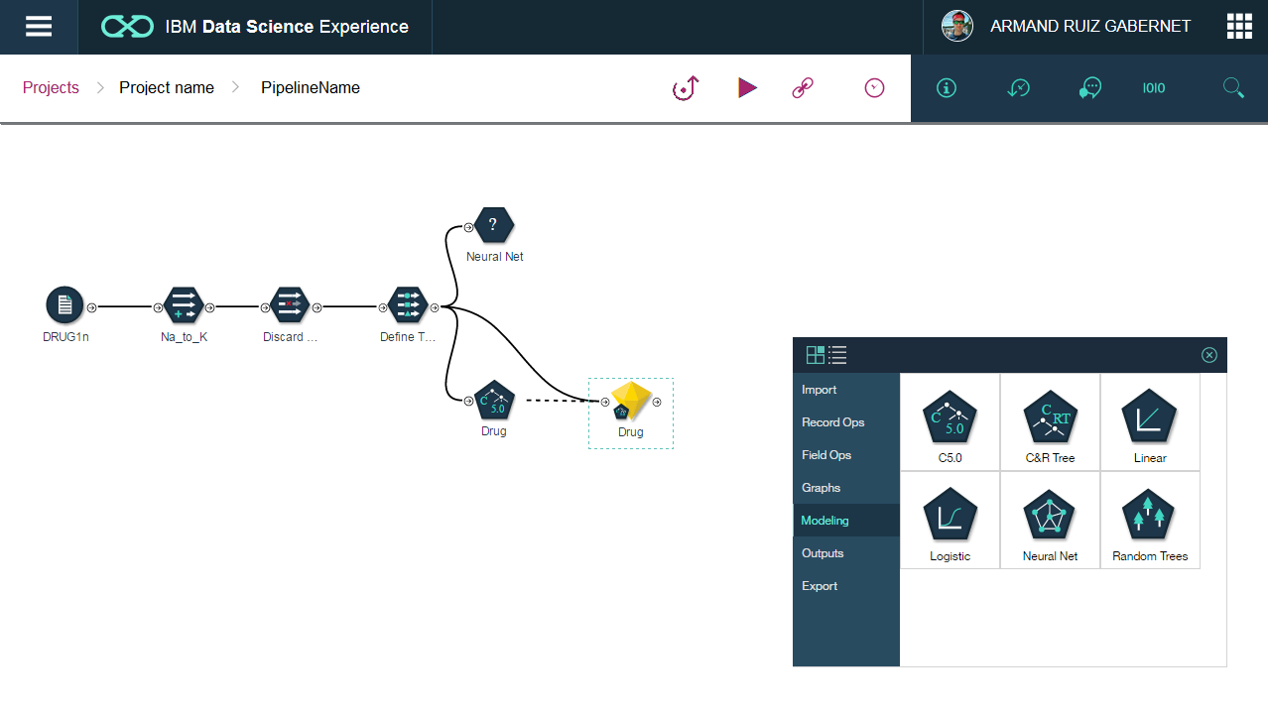
IBM SPSS And The Cloud
Powerful workbench for code-optional predictive analytics
SPSS Algorithms in Python, R and Scala and Interactive Model Visualization through IBM Data Science Experience
Delivered in the cloud through IBM Data Science Experience
Notes:
IBM SPSS is well known for it’s powerful workbenches (SPSS Statistics and SPSS Modeler) which a user can use to build code-optional predictive models and statistics. These workbenches are mostly deployed on-premises and sit on the workstation of the user. In 2017 light weight workbenches of both SPSS Statistics and SPSS Modeler will become available as a service in the cloud through the Data Science Experience (DSX) interface. You can see a screenshot of the cloud interface for SPSS Modeler (called Canvas) on the bottom left part of the slide.
For deployment Watson Machine Learning (ML) will become available in 2017. Watson ML can help deploy models built in the DSX environment (notebooks, Canvas etc) and this will generate a service which can be e.g. picked up by the developer to integrate into a new app for customers etc. You can see a screenshot of this on the right hand side of this slide and you can find more information on the next slide.

Slide 39
Wrap Up
Notes:
As part of our wrap up, I’d like to ask you to think about how you would apply this to YOUR business.
[instructor: lead the conversation and solicit input as needed]

Slide 40
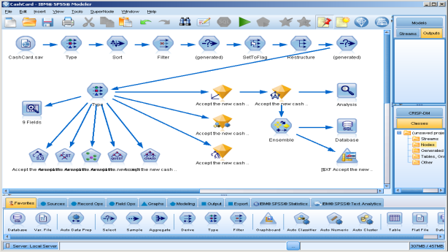

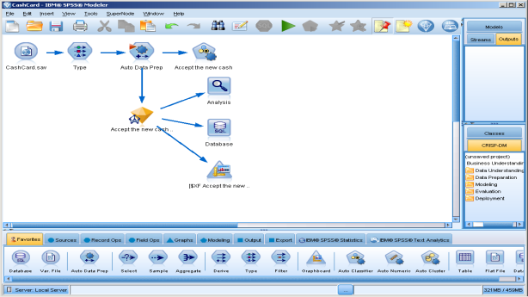

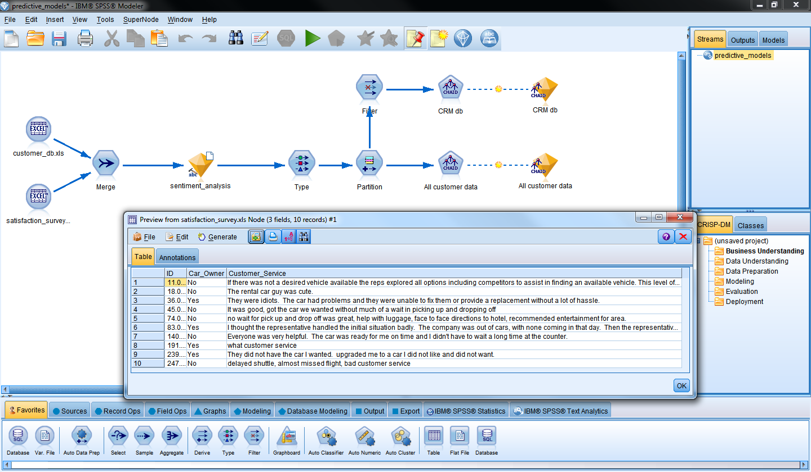

Predictive Analytics For All
Deep Predictive Capabilities With In-database, R and Python Integration, and Integrated Deployment
Expert User
Visual Workbench for Building Models of Any Complexity With Ability to Automate and Combine Tasks
Intermediate User
Simple, Easy-to-Use, Visual, Guided Analytical Discovery, Intelligent Automation and Visual Storytelling
Novice
Notes:
Simplifying engagement
Analytics must serve the need for collaboration between the “new buyers,” “new users” and “trusted experts”
Screenshot in the Novice section is from Watson Analytics which also has predictive capabilities but is not part of the IBM SPSS or Prescriptive portfolio

Slide 41
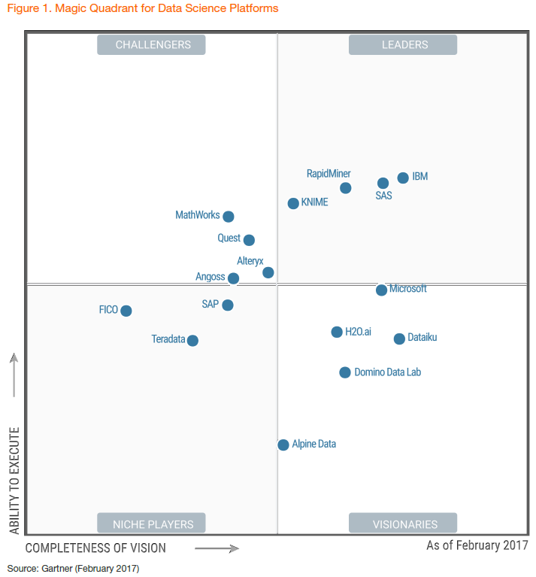
IBM Positioned In Leaders Quadrant Of The Gartner Magic Quadrant For Data Science Platforms
“IBM has a vast customer base and remains committed to modernizing and extending its data science and machine-learning capabilities. DSX [Data Science Experience) is likely to be one of the most attractive platforms in the future — modern, open, flexible and suitable for a range of users, from expert data scientists to business people.”
“Customers choose IBM SPSS because of its ability to support a broad range of data types, including unstructured data, and its solid product quality.”
“Surveyed IBM customers rated SPSS's model management highly, with praise for its breadth of models, accuracy and transparency in workflows, model deployment, monitoring for degradation and automatic retuning. SPSS provides excellent features for analytics governance: versioning, metadata and audit capabilities.”
Source: Gartner “Magic Quadrant for Data Science Platforms”, Alexander Linden, Peter Krensky, Jim Hare, Carlie Idoine, Svetlana Sicular, Shubhangi Vashisth 14 Feb. 2017
This graphic was published by Gartner, Inc. as part of a larger research document and should be evaluated in the context of the entire document. The Gartner document is available upon request from IBM. Gartner does not endorse any vendor, product or service depicted in its research publications, and does not advise technology users to select only those vendors with the highest ratings. Gartner research publications consist of the opinions of Gartner's research organization and should not be construed as statements of fact. Gartner disclaims all warranties, expressed or implied, with respect to this research, including any warranties of merchantability or fitness for a particular purpose.
Notes:
Slide approved for external use.
This slide can be used in any customer facing presentation to outline IBM’s leadership position in the 2017 Gartner Magic Quadrant (MQ) for Data Science Platforms. Customers can download a copy of the Gartner MQ report via this link: http://ibm.biz/gartner-ds-mq

Slide 42
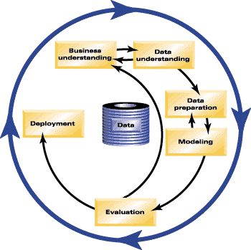
Getting Started
What do you want to achieve?
Short project with the biggest impact
ROI and Success Criteria are key to identifying early
Measure results
Quantify your ROI
97% of customers are able to pay for their investment within 11 months!
Use return to invest in the next project
Create new variables to enhance data
Embed in an application
Export to a spreadsheet
Hold out a sample of the data to test before deploying
Notes:
Start with a business problem
What do you want to achieve?
Short project with the biggest impact
ROI and Success Criteria are key to identifying early
Identify the data sources
Prepare data
Build the model
Test
Hold out a sample of the data to test before deploying
Deploy
Embed in an application
Export to a spreadsheet for customer calls
Measure results
Quantify your ROI
97% of customers are able to pay for their investment within 11 months!

Slide 43
Workshop Takeaways
Easy to use, visual interface
Short timeframe to be productive with actionable results
Does not require knowledge of programming language
No proprietary data formats
Open architecture
Business results focused
Leverages the investments already made in technology
Cost effective solution that delivers powerful results across organization
Full range of algorithms for your business problems
Big Data enabled (Hadoop, SQL Pushback)
End-to-end solution
Data preparation through real time interactions
Use structured, unstructured and semi-structured data
Integrated portfolio for business analytics
Scales from a single desktop to an enterprise deployments
Notes:
of the workshop.

Slide 44


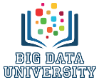
Next Steps
Explore
ibm.co/predictive
Try ibm.com/tryspss
Learn
www.BigDataUniversity.com
Course ID: 604
Engage
https://developer.ibm.com/ predictiveanalytics/
Notes:
Next Steps
Visit
Please be sure to visit the Advanced Analytics Zone at the Expo. The Predictive Analytics ped is #361-1. And stop by the demo room at the expo so you can try out the latest predictive products and solutions.
Learn
Be sure to sign up for our predictive analytics course on Big Data University. The course id is 604 – and it’s completely free.
Engage
Join the community! Please stop by the predictive analytics community and read expert blogs, engage in conversations, and much much more.
Try
Give predictive analytics a try! Visit ibm.com/tryspss and take advantage of our free trials today.

Slide 45
Tell me how you can apply this to your business
Notes:
As part of our wrap up, I’d like to ask you to think about how you would apply this to YOUR business.
[instructor: lead the conversation and solicit input as needed]

Slide 46

Notes:
<Let the attendees know that we have additional information available on IBM SPSS Modeler, including data sheets and analyst reports, as well as information on our training and services to help them make decisions on whether Modeler is the right data mining solution for their organization.
<Also let the attendees know that you have recommendations on books on data mining for anyone who is interested.
<Lastly, ask attendees to complete the evaluation form so we can use their feedback to continue to improve the workshop.>

Slide 47
Suggested Books
Appendix

Slide 48
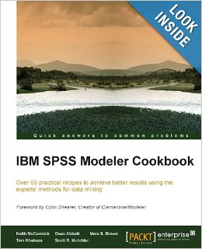
IBM SPSS Modeler Cookbook
From Amazon.com
IBM SPSS Modeler Cookbook
by Keith McCormick, Dean Abbott, Meta S. Brown, Tom Khabaza, Scott R. Mutchler
Paperback - 382 pages (October 2013) (also on Kindle)
ISBN : 1849685460
Written by those who teach and have been working with IBM SPSS Modeler since its beginnings. Full of practical examples that span the full gamut of capabilities.
Notes:
48
13/09/2017
Table of Contents Contents
Preface Chapter 1: Data Understanding Chapter 2: Data Preparation – Select Chapter 3: Data Preparation – Clean Chapter 4: Data Preparation – Construct Chapter 5: Data Preparation – Integrate and Format Chapter 6: Selecting and Building a Model Chapter 7: Modeling – Assessment, Evaluation, Deployment, and Monitoring Chapter 8: CLEM Scripting Appendix: Business Understanding

Slide 49
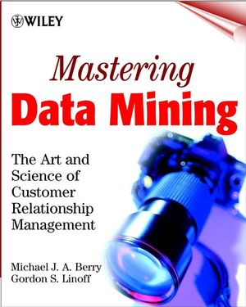
Data Mining Overview
From Amazon.com
Paperback: 512 pages
Publisher: Wiley; 1 edition (December 28, 1999)
Language: English
ISBN-10: 0471331236
ISBN-13: 978-0471331230 ;
Good introductory text on data mining for marketing from two top communicators in the field
Notes:
49
13/09/2017
Table of Contents
SETTING THE FOCUS. Data Mining in Context. Why Master the Art? Data Mining Methodology: The Virtuous Cycle Revisited. Customers and Their Lifecycles. THE THREE PILLARS OF DATA MINING. Data Mining Techniques and Algorithms. Data, Data Everywhere... Building Effective Predictive Models. Taking Control: Setting Up a Data Mining Environment. CASE STUDIES. Who Needs Bag Balm and Pants Stretchers. Who Gets What? Building a Best Next Offer Model for an Online Bank. Please Don't Go! Churn Modeling in Wireless Communication. Converging on the Customer: Understanding Customer Behavior in the Telecommunications Industry. Who Is Buying What? Getting to Know Supermarket Shoppers. Waste Not, Want Not: Improving Manufacturing Processes. The Societal Context: Data Mining and Privacy.

Slide 50
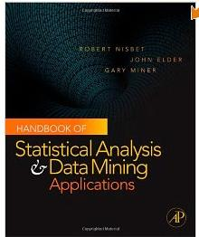
Handbook of Statistical Analysis and Data Mining Applications
Handbook of Statistical Analysis and Data Mining Applications
Robert Nisbet, John Elder IV, and Gary Miner
Academic Press (2009)
ISBN-10: 0123747651
An excellent guide to many aspects of data mining including Text mining.

Slide 51
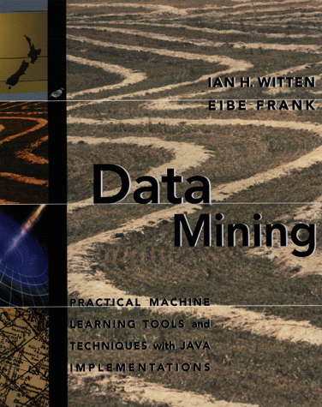
Data Mining Algorithms
From Amazon.com
Data Mining: Practical Machine Learning Tools and Techniques with Java Implementations
by Eibe Frank, Ian H. Witten
Paperback - 416 pages (October 13, 1999)
Morgan Kaufmann Publishers;
ISBN: 1558605525;
Best book I’ve found in between highly technical and introductory books. Good coverage of topics, especially trees and rules, but no neural networks.
Notes:
51
13/09/2017
Table of Contents Preface Acknowledgements 1. What's It All About? 2. Input: Concepts, Instances, Attributes 3. Output: Knowledge Representation 4. Algorithms: The Basic Methods 5. Credibility: Evaluating What's Been Learned 6. Implementations: Real Machine Learning Schemes 7. MOVING ON: ENGINEERING THE INPUT AND OUTPUT 221 8. Nuts And Bolts: Machine Learning Algorithms In Java 9. Looking Forward References Index

